Slide 1
Service Fabric

Slide 2


Slide 3
Microservice

Slide 4
什么是Service Fabric
1.传统服务的弊端
2.微服务
3. Service Fabric

Slide 5

传统服务的弊端
1.因为发布新特性会导致长时间的停机，所以就很少有机会发布新特性。
2.扩展又慢又贵，因为每个部分都要被复制一份，即使是不用的部分。
3.可用性和可靠性通过硬件冗余达到，更贵，更复杂

Slide 6

1.因为发布新特性会导致长时间的停机，所以就很少有机会发布新特性。
Competitive business pressures demand that applications continuously evolve, adding new features and functionality while remaining available 24x7. For example, it is no longer acceptable for a bank website to have a maintenance window, whereas even a few years ago it was the norm. Similarly, an e-commerce site that’s down for even a short time will drive customers to one of many competitors that can serve them at that moment. Failure to meet these demands can mean the difference between staying relevant and losing business.

Slide 7
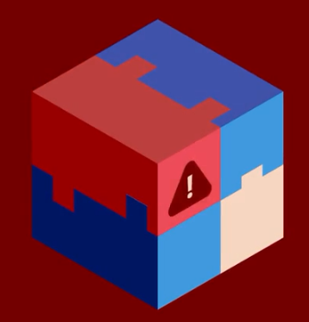
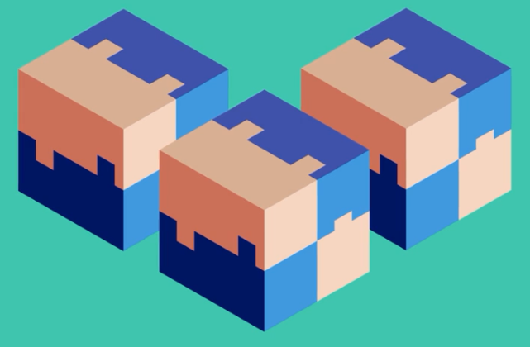
2.扩展又慢又贵，因为每个部分都要被复制一份，即使是不用的部分。

Slide 8
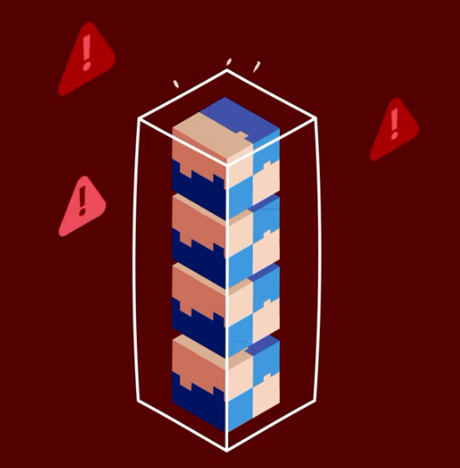
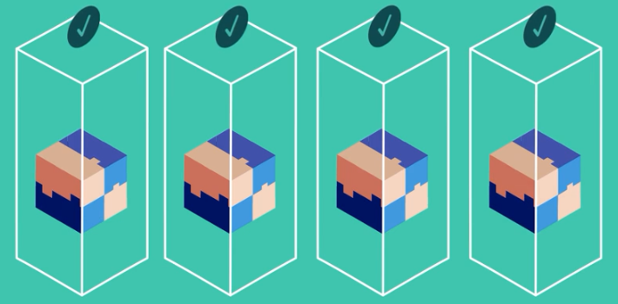
3.可用性和可靠性通过硬件冗余达到，更贵，更复杂

Slide 9

Microservices
微服务 != 微信服务
微服务 != 微信服务
微服务 != 微信服务
Microservices: An application revolution powered by the cloud
https://azure.microsoft.com/en-us/blog/microservices-an-application-revolution-powered-by-the-cloud/

Slide 10
What is a microservice?
Microservice applications are composed of small, independently versioned, and scalable customer-focused services that communicate with each other over standard protocols with well-defined interfaces.

Slide 11



微服务的进化

Slide 12
1.发布时间长 --------->单个服务发布， 0 停机
2.扩展又慢又贵 ------->单个服务升级， 有针对性
3.可用性和可靠性通过硬件冗余达到，更贵，更复杂

Slide 13
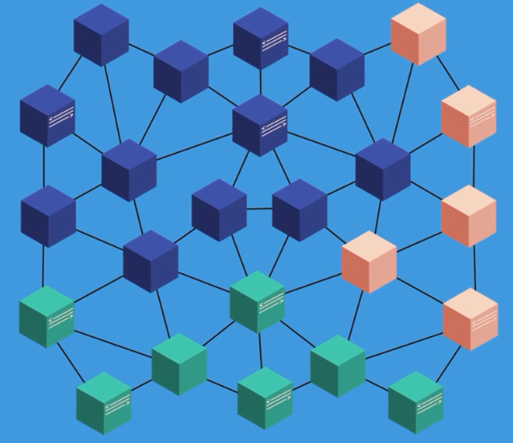
Developer needs write additional code. Inter service communication and handling failures

Slide 14
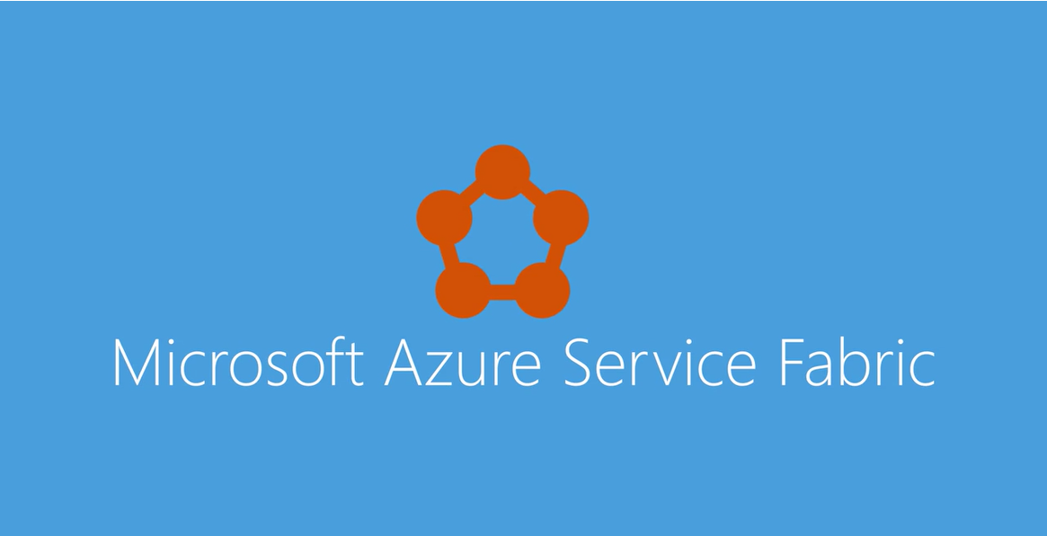
Azure Service Fabric

Slide 15
Azure service fabric is an application platform that simplifies building, deploying micro service base applications, to provide organization with scalable, agile and reliable applications.

Slide 16
Why Service Fabric

Slide 17
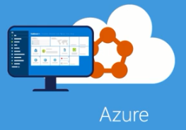
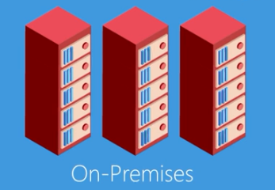
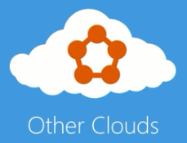
1.多平台
Whether they are running Azure, On-Premises, or in Other clouds, and developers get focus on code and delivery business layer. Which means customer get new features faster.

Slide 18
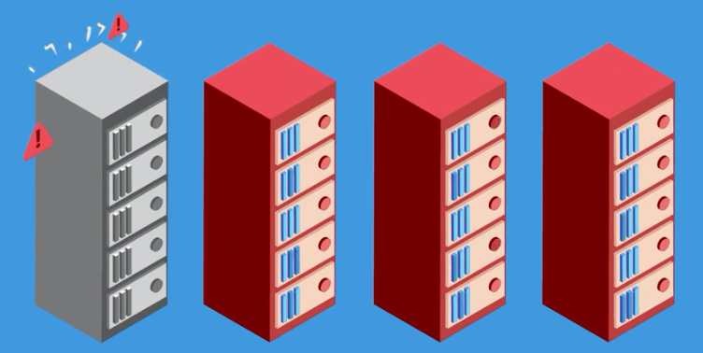
2.xxx
Azure service fabric protects applications against failures by modering cluster and automatically aiting to minegit issues.

Slide 19
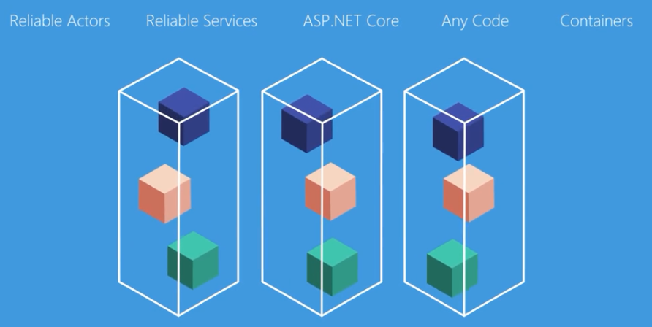
3.models

Slide 20
Azure service fabric provide built-in program models to simplify developing micro services.
Not only that, ilet’s you run any application code. In additional to support traditional stateless micro services, Azure service fabric support stateful micro service, core locating compute and data to reduce lll and hands performance will providing reliability through replication and persistence.

Slide 21
4. Data partitions
Data partitions in service will long with dynamic resource balancing make scaling on the demand routing.
Rolling updates is able zero application down time. And health check fail, service fabric automatically rolls back application to previous version.
Azure service fabric was born from xx years to experience me critical cloud services. And today, hundreds of organizations are releasing same benefits of micro service approach.
Not only that, but several key Microsoft products run on Azure service fabric.

Slide 22
5. Upgrade
Rolling updates is able zero application down time. And health check fail, service fabric automatically rolls back application to previous version.
Azure service fabric was born from xx years to experience me critical cloud services. And today, hundreds of organizations are releasing same benefits of micro service approach.
Not only that, but several key Microsoft products run on Azure service fabric.

Slide 23
6. Born
Azure service fabric was born from our years to experience delivering metion critical cloud services. And today, hundreds of organizations are releasing same benefits of micro service approach.

Slide 24
7. Tools
Not only that, but several key Microsoft products run on Azure service fabric.
Service fabric support from main develop tools and program models. Improve developers productivity. This can be use built stateless service. The traditional way.
Where nows stateful micro service, will compute and data collocated to further decrease app complexity.

Slide 25
8. Powerful management
Azure service fabric also provide powerful management capability, include stage management, application lifecycle management with zero downtime upgrades. Easy service discovery, and details diagnosis and manzheri.

Slide 26
9. Linux
In addition, with support for Linux, developer can use tools they know to build and deploy service fabric application on Linux.
Azure service fabric is design to meet needs of many industries. Include manufacturing, financial service, gaming, IOT or any application benefits from scalblelity and x.
Azure service fabric simplify building and deploying micro service base applications in Azure, On-Premises, in other Clouds and is available on Windows and Linux as well. With Azure service fabric, organization can deliver customer more features faster. To drive better business resolves.

Slide 27
10. Industries
Azure service fabric is design to meet needs of many industries. Include manufacturing, financial service, gaming, IOT or any application benefits from scalability and relaeci.
Azure service fabric simplify building and deploying micro service base applications in Azure, On-Premises, in other Clouds and is available on Windows and Linux as well. With Azure service fabric, organization can deliver customer more features faster. To drive better business resolves.

Slide 28
Stateless and stateful microservices for Service Fabric
Stateless microservices (such as protocol gateways and web proxies) do not maintain a mutable state outside a request and its response from the service. Azure Cloud Services worker roles are an example of a stateless service.
Stateful microservices (such as user accounts, databases, devices, shopping carts, and queues) maintain a mutable, authoritative state beyond the request and its response. Today's Internet-scale applications consist of a combination of stateless and stateful microservices.

Slide 29
Application lifecycle management
持续集成和持续交付（CI/CD）
design, development, testing, deployment, upgrading, maintenance, and removal.

Slide 30
So you want to learn about Service Fabric?
https://mva.microsoft.com/en-US/training-courses/building-microservices-applications-on-azure-service-fabric-16747?l=tbuZM46yC_5206218965

Slide 31
built-in programming models

Slide 32
Service Fabric Deploy
https://try.servicefabric.azure.com/

Slide 33
Service Fabric 术语

Slide 34
群集
节点
分区

Slide 35
Service Fabric 精通预告
新中国Service Fabric的领军人物 Sam Pang

